Slide 1
Objectives
Describe 10 basic principles of system development.
Define problems, opportunities, and directives—the triggers for systems development projects.
Describe the PIECES framework for categorizing problems, opportunities, and directives.
3-<number>
Notes:
Chapter 2 – Information System Building Blocks
No additional notes

Slide 2
Process of System Development
System development process – a set of activities, methods, best practices, deliverables, and automated tools that stakeholders (Chapter 1) use to develop and continuously improve information systems and software (Chapters 1 and 2).
  Many variations
  Using a consistent process for system development:
    Create efficiencies that allow management to shift resources between projects
    Produces consistent documentation that reduces lifetime costs to maintain the systems
    Promotes quality
3-<number>
Notes:
Chapter 2 – Information System Building Blocks
Teaching Notes
In teaching this course we sometimes begin by asking students to imagine they have to develop some complex information system, such as a new course registration system for the university. Then we ask them how they would proceed to determine what needs to be included in this information system. After a little discussion we ask them to compare this hypothetical process to what they have done with assignments in programming classes. The point is that programming assignments are not at all like real world information systems, which need a much more detailed development process. That sells why students need this course.
Some textbooks use the term systems development life cycle. We elected not to use that term because it invokes negative connotation for many instructors. Some associate it with a pure waterfall development approach (which we consider unfair).
We differentiate between development and operation (sometimes called production). This chapter focuses on development and different methodologies and strategies employed for system development.

Slide 3
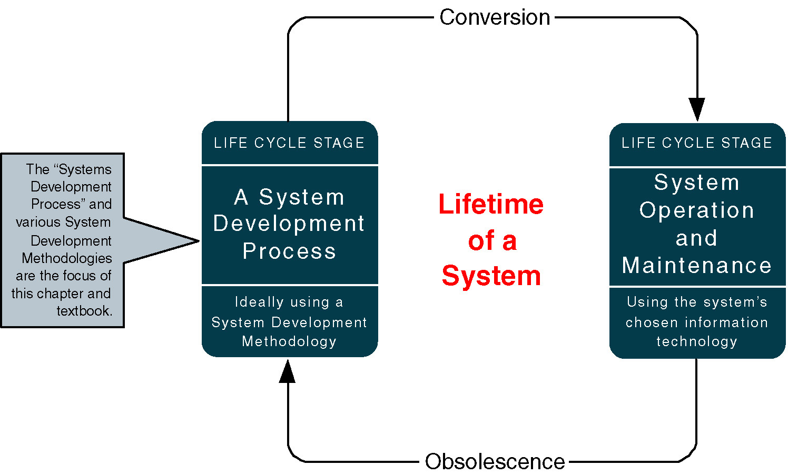
A System Life Cycle
3-<number>
Notes:
Chapter 2 – Information System Building Blocks
Teaching Notes
This slide formally differentiates between the life cycle and a systems development methodology that is used to to execute the development stage of the life cycle.
A common synonym for “system operation” is “production.”

Slide 4
Principles of System Development
Get the system users involved.
Use a problem-solving approach.
Establish phases and activities.
Document through development.
Establish standards.
Manage the process and projects
Justify systems as capital investments.
Don’t be afraid to cancel or revise scope.
Divide and conquer.
Design systems for growth and change.
3-<number>
Notes:
Chapter 2 – Information System Building Blocks
Teaching Notes
Note that these principles apply regardless of which methodology is used.

Slide 5
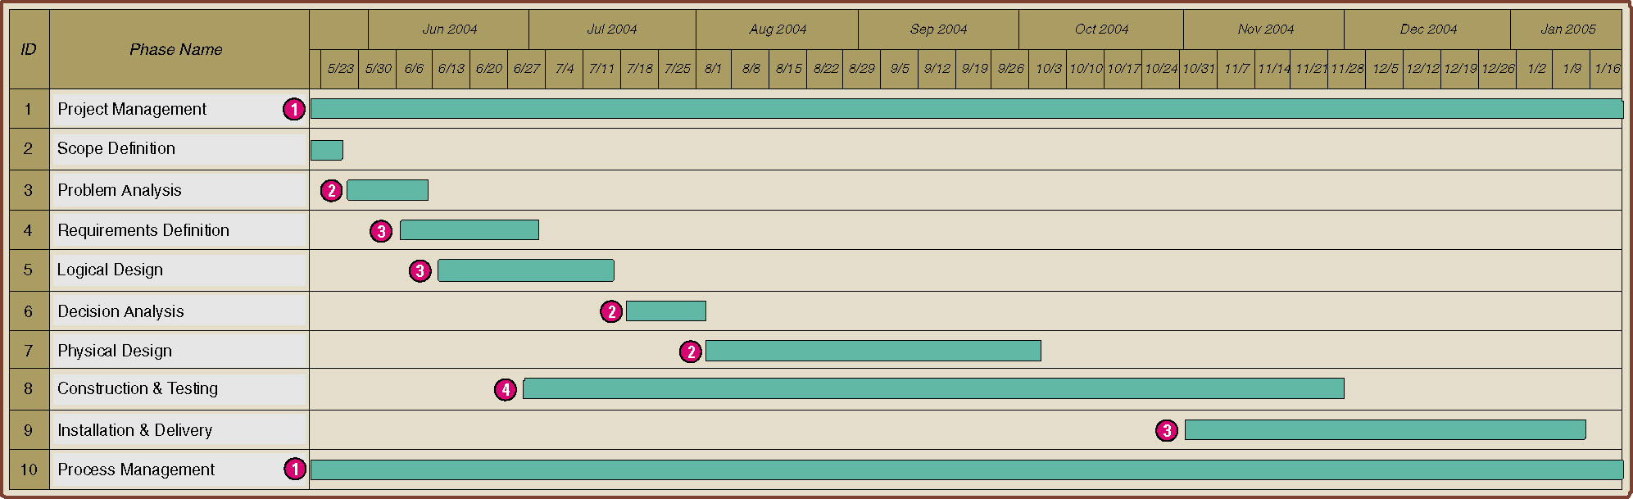
Establish Phases and Activities
Overlap of System Development Phases
3-<number>
Notes:
Chapter 2 – Information System Building Blocks
Teaching Notes
Every project is different depending on the size, complexity, and development methodology or route. The key point to emphasize in the figure is that the phases occur in parallel. It is important that students not misinterpret that the phases in this chapter are sequential.
Note that project and process management are illustrated as ongoing activities that last the duration of a project. (The next chapter will focus on project and process management as well as the construction and use of Gantt Charts such as the one above.)

Slide 6
Where Do Systems Development Projects Come From?
Problem – an undesirable situation that prevents the organization from fully achieving its purpose, goals, and/or objectives.
Opportunity – a chance to improve the organization even in the absence of an identified problem.
Directive - a new requirement that is imposed by management, government, or some external influence.
3-<number>
Notes:
Chapter 2 – Information System Building Blocks
Teaching Notes
Emphasize that problems, opportunities, and directives can either be planned or unplanned.

Slide 7
Use a Problem-Solving Approach
Classical Problem-solving approach
  Study and understand the problem, its context, and its impact.
  Define the requirements that must be meet by any solution.
  Identify candidate solutions that fulfill the requirements, and select the “best” solution.
  Design and/or implement the chosen solution.
  Observe and evaluate the solution’s impact, and refine the solution accordingly.
3-<number>
Notes:
Chapter 2 – Information System Building Blocks
Teaching Notes
It can be useful to walk through a non-IS example of problem-solving, such as diagnosing a car problem or going to the restaurant because you are hungry.

Slide 8
The PIECES Problem-Solving Framework (pg 77 & 78)
P the need to improve performance
I the need to improve information (and data)
E the need to improve economics, control costs, or increase profits
C the need to improve control or security
E the need to improve efficiency of people and processes
S the need to improve service to customers, suppliers, partners, employees, etc.
Notes:
Chapter 2 – Information System Building Blocks
Teaching Notes
We really emphasize PIECES as a useful way to characterize all problems. Later, we teach our students to use PIECES to analyze requirements and solutions as well.
It can be useful to apply the PIECES framework to a project from the instructor’s professional background.
Refer to the figure in the text for the PIECES checklist.

Slide 9
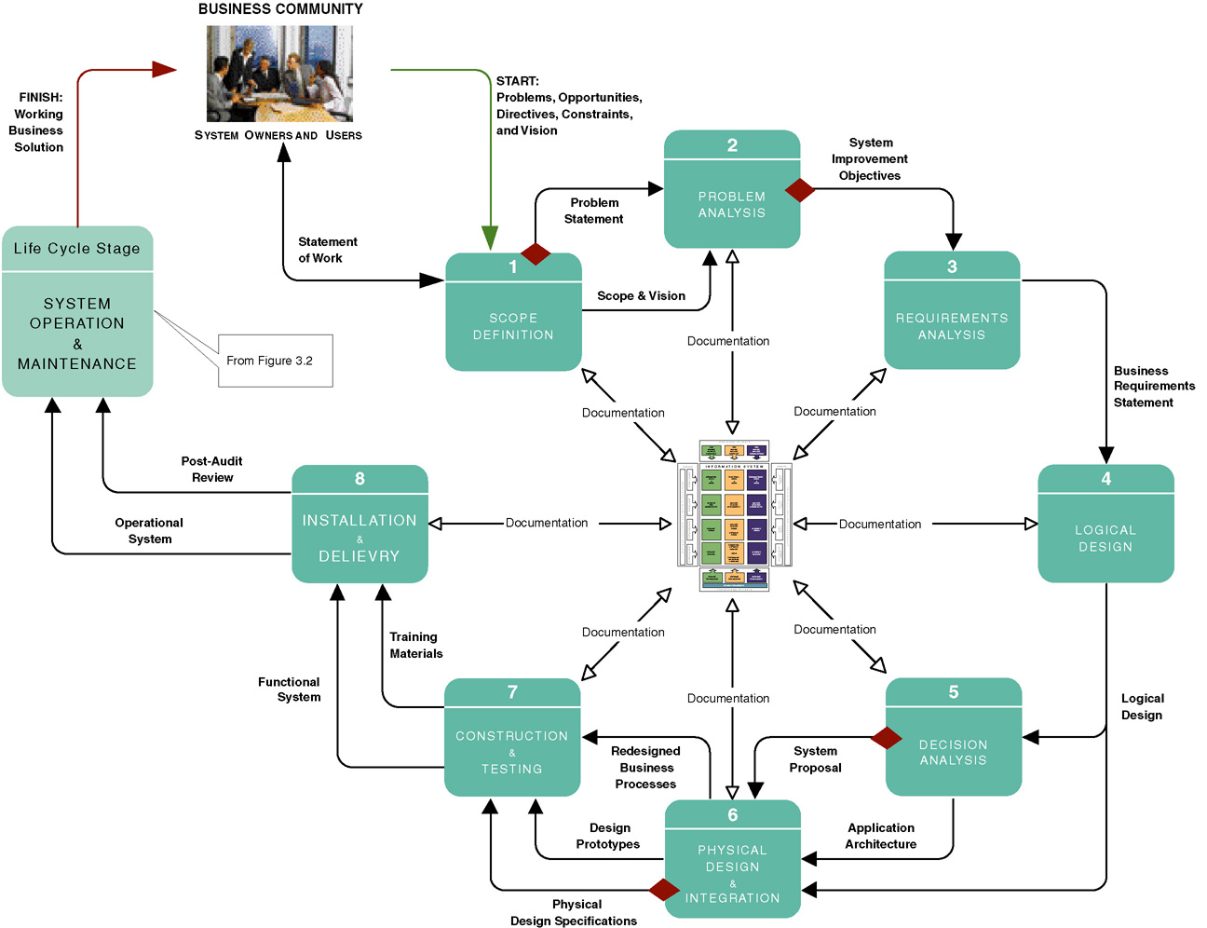
The Classic Project Phases (FAST)
3-<number>
Notes:
Chapter 2 – Information System Building Blocks
Teaching Notes
This is not meant to be interpreted as a “waterfall” model.
Make sure that the students recognize that this slide represents one methodology that the authors call FAST. There are many methodologies and variations on this slide.
Note that documentation goes on at every phase. These are the “deliverables” of the project.
The diamonds reflect typical “go” or “no go” feasibility checkpoints consistent with the creeping commitment philosophy.
At the center of the figure is the Building Blocks View of System Development, shown on the next slide.

Slide 10
Project Phases (pg 79)
FAST - (Framework for the Application of Systems Thinking ) a hypothetical methodology used throughout this book to demonstrate a representative systems development process.
Each methodology will use different project phases.
FAST Phases | Classic Phases (from Chapter 1)
 | Project Initiation | System Analysis | System Design | System Implementation
Scope Definition | X
Problem Analysis | X | X
Requirements Analysis |  | X
Logical Design |  | X
Decision Analysis | (a system analysis transition phase)
Physical Design and Integration |  |  | X
Construction and Testing |  |  | X | X
Installation and Delivery |  |  |  | X
3-<number>
Notes:
Chapter 2 – Information System Building Blocks
Conversion Notes
This is a new slide in the seventh edition
Teaching Notes
The classic SDLC phases were presented in chapter 1. Now we present the FAST phases. This switch often confuses students. FAST is taught for two reasons:
1. The classic SDLC phases are really two general for teaching.
2. FAST allows students to see a methodology in action.
It is important for students to see that FAST is a methodology and how it fits into the classic SDLC phases.

Slide 11
Scope Definition Phase (pg 79)
Problem statement – a statement and categorization of problems, opportunities, and directives; may also include constraints and an initial vision for the solution. Synonyms include preliminary study and feasibility assessment.
Constraint – any factor, limitation, or restraint that may limit a solution or the problem-solving process.
Scope creep – a common phenomenon wherein the requirements and expectations of a project increase, often without regard to the impact on budget and schedule.
Statement of work – a contract with management and the user community to develop or enhance an information system; defines vision, scope, constraints, high-level user requirements, schedule, and budget. Synonyms include project charter, project plan, and service-level agreement.
3-<number>
Notes:
Chapter 2 – Information System Building Blocks
Teaching Notes
If any of these will be a later assignment, it can be helpful to make note of it.

Slide 12
Requirements Analysis Phase (pg 83)
What capabilities should the new system provide for its users?
What data must be captured and stored?
What performance level is expected?
What are the priorities of the various requirements?
3-<number>
Notes:
Chapter 2 – Information System Building Blocks
Conversion Notes
This slide is new in the seventh edition.

Slide 13
Logical Design Phase (pg 84)
Logical design – the translation of business user requirements into a system model that depicts only the business requirements and not any possible technical design or implementation of those requirements. Common synonyms include conceptual design and essential design.
System model – a picture of a system that represents reality or a desired reality. System models facilitate improved communication between system users, system analysts, system designers, and system builders.
Analysis paralysis – a satirical term coined to describe a common project condition in which excessive system modeling dramatically slows progress toward implementation of the intended system solution.
3-<number>
Notes:
Chapter 2 – Information System Building Blocks
Teaching Notes
After finishing this chapter, students are liable to think that this course is teaching "analysis paralysis," since their prior experience may consist of short programming assignments. But without the right amount of analysis you will never deliver what the users want and need.

Slide 14
Decision Analysis Phase (pg 85)
Candidate solutions evaluated in terms of:
  Technical feasibility – Is the solution technically practical? Does our staff have the technical expertise to design and build this solution?
  Operational feasibility – Will the solution fulfill the users’ requirements? To what degree? How will the solution change the users’ work environment? How do users feel about such a solution?
  Economic feasibility – Is the solution cost-effective?
  Schedule feasibility – Can the solution be designed and implemented within an acceptable time?
  Risk feasibility – What is the probability of a successful implementation using the technology and approach?
3-<number>
Notes:
Chapter 2 – Information System Building Blocks
Teaching Notes
These will be covered in detail in Chapter 11.

Slide 15
Model-Driven Development Strategy (pg 94)
Model-driven development – a system development strategy that emphasizes the drawing of system models to help visualize and analyze problems, define business requirements, and design information systems.
  Process modeling – a process-centered technique popularized by the structured analysis and design methodology that used models of business process requirements to derive effective software designs for a system.
  Data modeling – a data-centered technique used to model business data requirements and design database systems that fulfill those requirements.
  Object modeling – a technique that attempts to merge the data and process concerns into singular constructs called objects. Object models are diagrams that document a system in terms of its objects and their interactions.
3-<number>
Notes:
Chapter 2 – Information System Building Blocks
Teaching Notes
The model-driven “route” is most typically associated with “methodologies based on structured analysis and design, information engineering (data modeling), or object-oriented analysis and design (use-case, UML, etc.).
It was not the intent to teach the techniques in this chapter. That is why we elected not to include sample models that the students would not truly understand until they read the modeling chapters themselves.

Slide 16
Logical vs. Physical Models
Logical model - a pictorial representation that depicts what a system is or does.
Physical model - a technical pictorial representation that depicts what a system is or does and how the system is implemented.
3-<number>
Notes:
Chapter 2 – Information System Building Blocks
Conversion Notes
This slide is new to the seventh edition.
Teaching Notes
We always emphasize to students that logical models are built in the analysis phases while physical models are built in the design phases after the implementation architecture is selected.

Slide 17
CASE Tools (pg 108)
Computer-aided systems engineering (CASE) tools are software programs that automate or support the drawing and analysis of system models and provide for the translation of system models into application programs.
3-<number>
Notes:
Chapter 2 – Information System Building Blocks
Conversion Notes
In this edition, the term CASE is restricted to model-driven technology (either forward engineering, reverse engineering, or both).
Teaching Tips
Different CASE tools may refer to their repository as a dictionary or encyclopedia.
Some CASE tools maintain a repository at a project-by-project level. Others provide or integrate into a project-independent repository to promote sharing of models and specifications between projects.
Most CASE tools interface with one or more ADEs to provide round-trip engineering that supports the full life cycle.

Slide 18
Application Development Environments (pg 109)
Application development environments (ADEs) – an integrated software development tool that provides all the facilities necessary to develop new application software with maximum speed and quality. A common synonym is integrated development environment (IDE)
  ADE facilities may include:
    Programming languages or interpreters
    Interface construction tools
    Middleware
    Testing tools
    Version control tools
    Help authoring tools
    Repository links
3-<number>
Notes:
Chapter 2 – Information System Building Blocks
Teaching Notes
ADE is compatible with both model-driven and rapid application development methodologies. In contemporary literature, it is the basis for all RAD methodologies.
Many ADEs provide links to a repository to support sharing of program code.
Most ADEs either interface with one or more CASE tool repositories or they provide rudimentary CASE-like modeling tools within the ADE. This allows developers to integrate RAD and MDD techniques as was demonstrated in the first hybrid route presented earlier in the chapter.

Slide 19
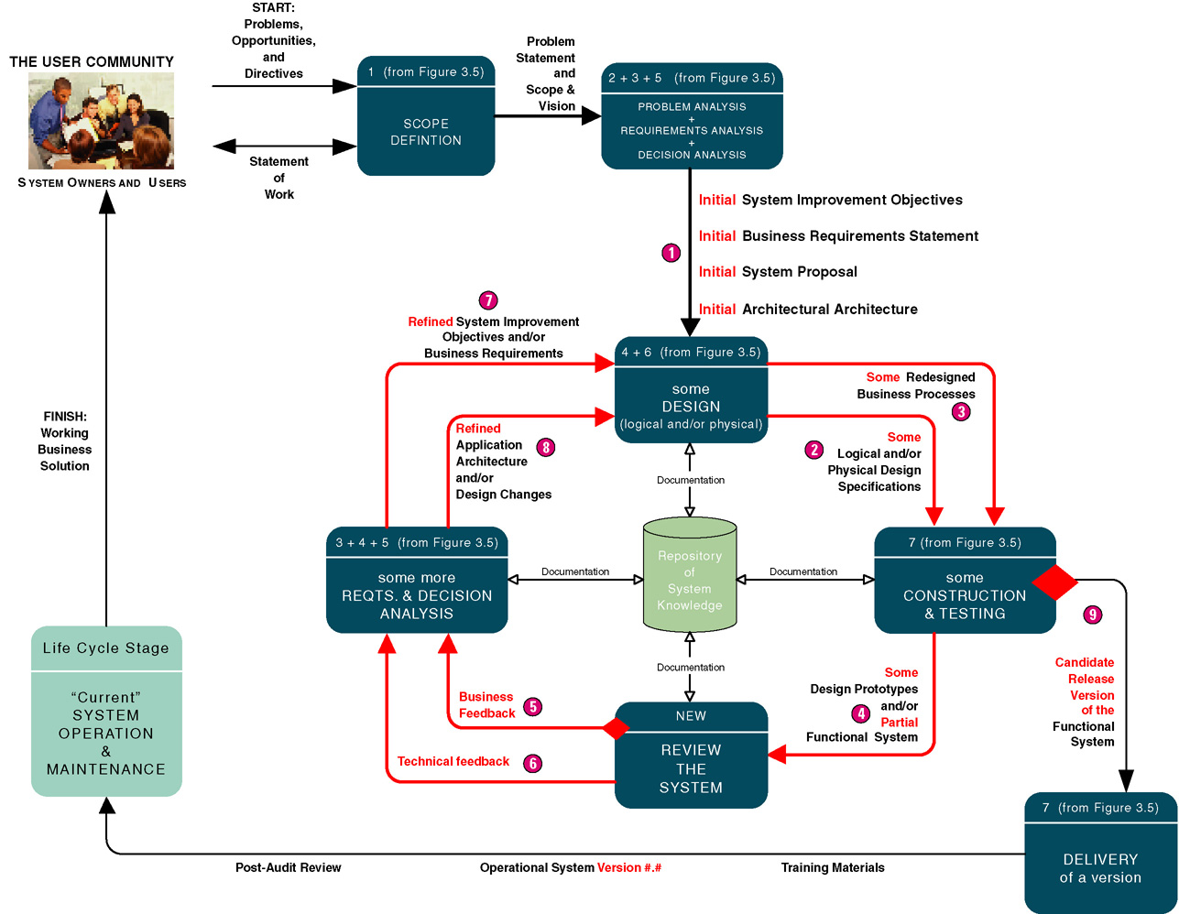
Rapid Application Development Strategy (pg 98)
3-<number>
Notes:
Chapter 2 – Information System Building Blocks
Teaching Notes
The rapid application development approach is most commonly associated with an incremental or iterative approach to system development. It is very popular for smaller and relatively structured projects in which requirements are fairly well understood from the beginning of the project.

Slide 20
Rapid Application Development Strategy
Advantages
Disadvantages
User requirements often uncertain or imprecise
Encourages active user and management participation
Projects get higher visibility and support
Stakeholders see working solutions more rapidly
Errors detected earlier
Testing and training are natural by-products
More natural process because change is expected
May encourage "code, implement, repair" mentality
Can solve wrong problem since problem analysis is abbreviated
May discourage analysts from considering alternatives
Stakeholders reluctant to throw away prototype
Emphasis on speed can adversely impact quality
3-<number>
Notes:
Chapter 2 – Information System Building Blocks
Conversion Notes
This slide is new to the seventh edition.

